Slide 1
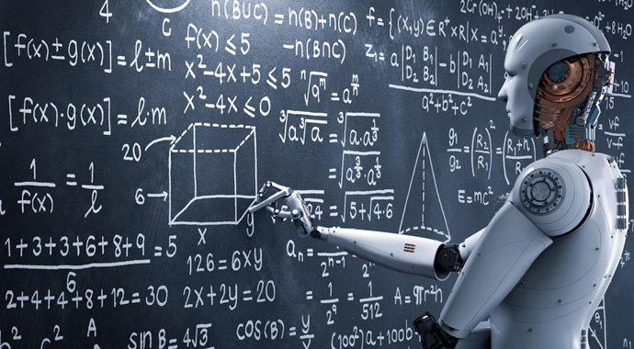
Machine learning

Slide 2
CONTENTS
Introduction
Methods of learning
Applications
Opportunities
Advantages
Threats
Future scope
Conclusion

Slide 3
What is machine learning?
Machines that learn and adopt to their environments
Similar to living organisms
Multimodal is goal
AGI-endgame

Slide 4
Why machine learning?
Develop systems that can automatically adapt and customize themselves to individual users.
Discover new knowledge from large databases.
Ability to minic human and replace certain monotonous tasks.
Develop systems that are too difficult /expensive to construct manually.

Slide 5
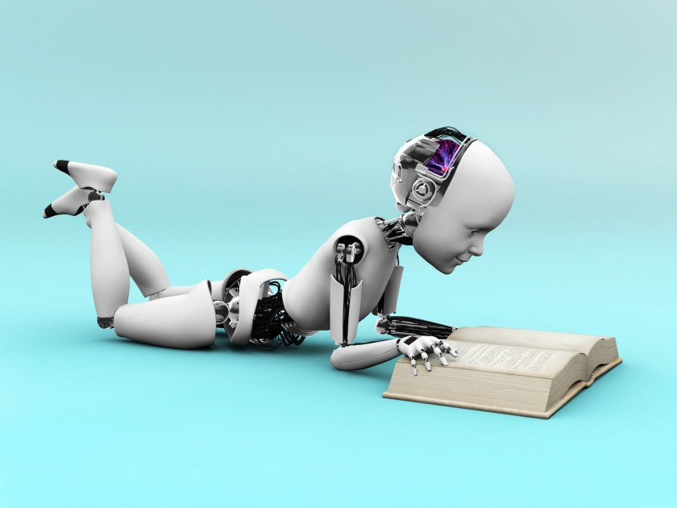
Machine learning methods
Supervised learning
Unsupervised learning
Semi-supervised learning
Reinforcement learning

Slide 6
Supervised learning
Both input and desired output data are provided.
Input and output data are labelled for classification for future data processsing.

Slide 7
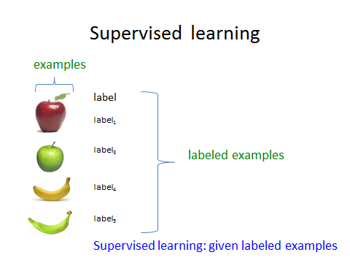

Slide 8
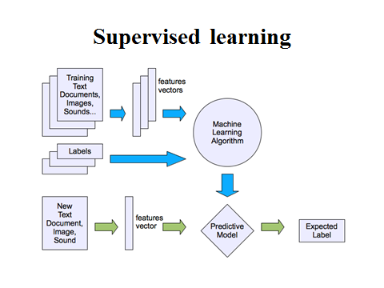

Slide 9
Unsupervised learning
Information that is neither classified nor labeled and allowing the algorithm to act on that information without guidance.
It group unsorted information according to similarities and differences even though there are no categories provided.

Slide 10
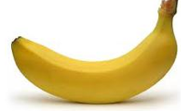
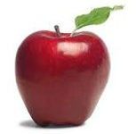
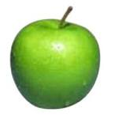
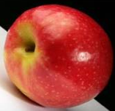
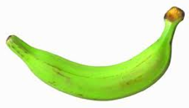
Unsupervised learning
Unupervised learning: given data, i.e. examples, but no labels

Slide 11
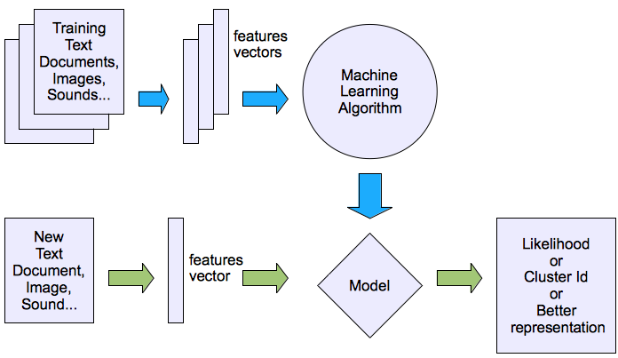
Unsupervised learning

Slide 12
Semi-supervised learning
Uses both labeled data and unlabeled data for learning.
When labeling of data is a costly affair semi-supervised techniques could be very useful.
Examples: generative models, self-training, co-training.

Slide 13
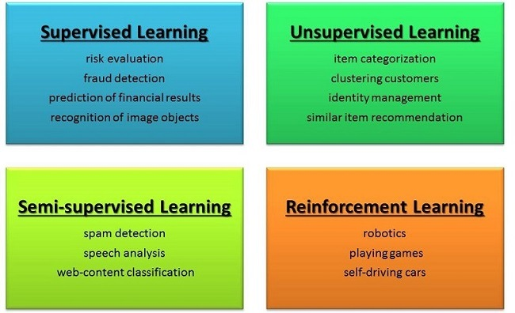

Slide 14
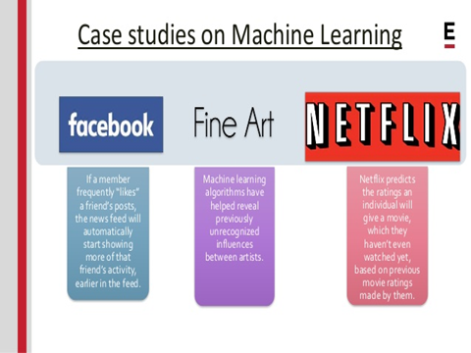

Slide 15
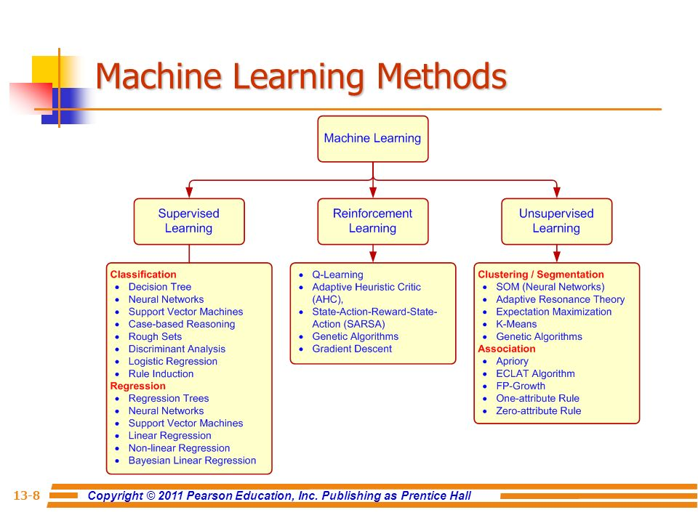

Slide 16
Performance evaluation
Optimal: checkers, Rubik’s cube, some poker
Strong super-human: chess, scrabble
Super-human: cars, crosswords
Par-human: Image recognition, OCR
Sub-human: translation, speech recognition

Slide 17
Applications
Call centers
Military
Political
National security
policing

Slide 18
Advantages
Image recognition
Voice recognition
Optical character recognition
Advanced customization
Intelligent data analysis
Sensory data analysis

Slide 19
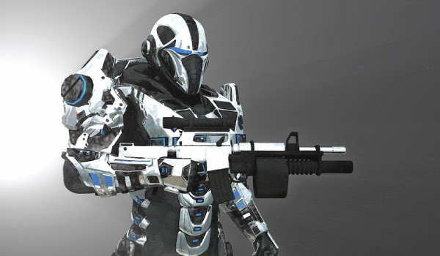
Threats
Unemployment due to automation:
What are the new jobs created?
Widen the inequality gap:
Existential risk
Basic income guarantee
Legal + ethical issues:
machine rights
New laws

Slide 20
Predictions??
More robots
More automation
Cyborgs
Singularity
Self-aware?
Ethics
Advances in science and medicine

Slide 21
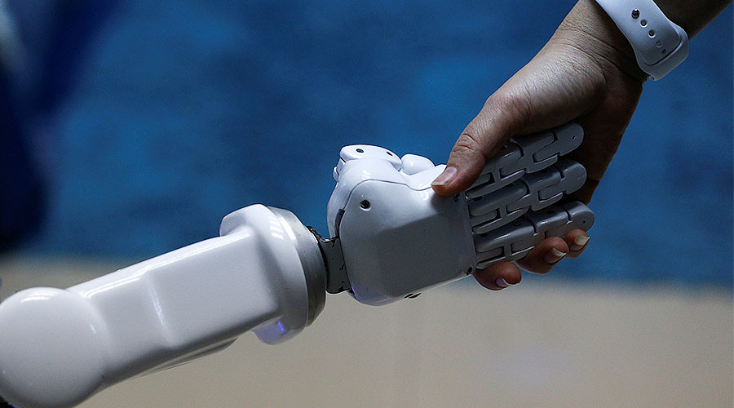
conclusion
We have a simple overview of some techniques and algorithms in machine learning. Furthermore, there are more and more techniques apply machine learning as a solution. In the future, machine learning will play an important role in our daily life.

Slide 22
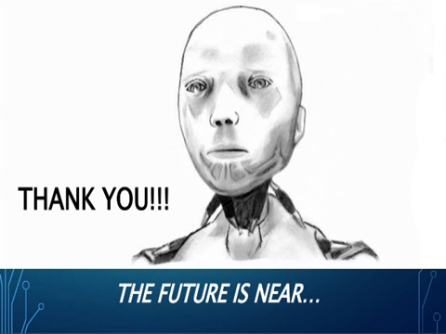

Slide 23
